Slide 1
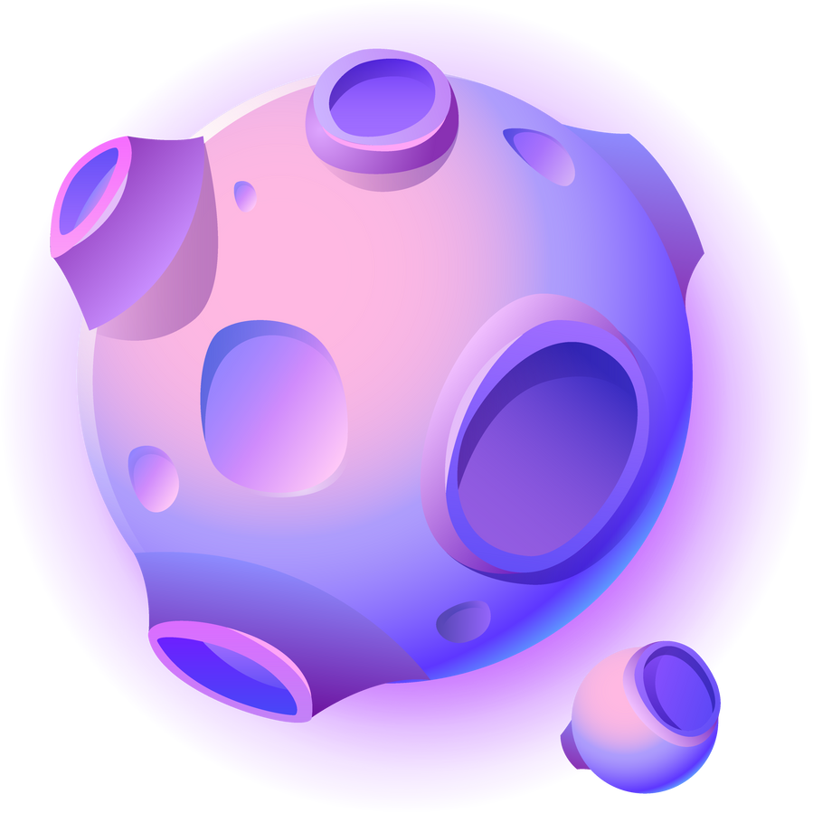

Hack2Future
Team aToM

Slide 2
Team Details
Parishri Shah
Yashraj Kadam
Arya Sali
Ravi Raj

Slide 3


Idea Brief
The project involves developing a scalable AutoML-MLOps platform that automates the entire machine learning lifecycle, from data ingestion to model deployment and monitoring. It integrates open-source AutoML tools to streamline model building and optimization while incorporating MLOps for continuous deployment, monitoring, and retraining of models. Designed with both technical and non-technical users in mind, the platform will provide an intuitive interface for easy interaction and collaboration. The goal is to deliver a flexible, scalable prototype that accelerates AI adoption by simplifying and automating the ML workflow, ensuring models are reliable and maintainable at scale.

Slide 4

Unique Features
Full MLOps Integration - Unlike H2O.ai, which primarily focuses on AutoML, our platform provides seamless end-to-end MLOps functionality. This includes automated deployment pipelines, model versioning, continuous integration/continuous deployment (CI/CD), and monitoring, allowing models to be maintained, retrained, and monitored with minimal manual intervention.
Edge and Multi-Cloud Support - While H2O.ai mainly supports cloud-based environments, our platform offers flexible deployment options on edge devices, multi-cloud environments (AWS, Azure, GCP), and hybrid setups. This enables real-time inference at the edge, ideal for IoT, healthcare, and manufacturing use cases where low-latency predictions are critical.
Advanced Model Monitoring and Drift Detection - Our platform includes real-time model monitoring and drift detection capabilities using integrated tools like Evidently.ai, which can automatically trigger retraining processes when models start to degrade. This ensures that models remain accurate and effective in production without requiring constant human oversight.

Slide 5
Customizable, Low-Code Pipelines - Users can build custom machine learning pipelines with drag-and-drop functionality, offering more flexibility in data preprocessing, feature engineering, and model evaluation. The platform is designed to support both low-code/no-code workflows for non-experts and deeper customization for advanced users, making it highly adaptable to different needs.
Enhanced Explainability and Compliance Tools - Our solution integrates advanced Explainable AI (XAI) tools such as LIME, SHAP, and Eli5, allowing for more transparency in model decision-making compared to H2O.ai’s limited XAI features. It also includes built-in compliance monitoring to meet industry regulations like GDPR and HIPAA, ensuring that data privacy and model auditing standards are maintained.

Slide 6
Tech Stack
AutoML - H2O.ai, AutoKeras, TPOT, FLAML (Fast Lightweight AutoML): For comprehensive automated machine learning capabilities.
MLOps -
Kubeflow, MLflow, Airflow: For managing CI/CD pipelines and version control.
Prometheus, Evidently.ai: For model monitoring and performance tracking.
Docker, Kubernetes: For containerized and scalable deployments, including multi-cloud and edge deployments.
Data Processing -
Apache Spark, Ray: For distributed data processing.
Featuretools: For automated feature engineering.
Model Deployment -
TensorFlow Serving, TorchServe: For serving machine learning models at scale.
Explainability -
LIME, SHAP, Eli5: For model interpretability.
Collaboration -
Git, DVC (Data Version Control): For team collaboration, dataset versioning, and experiment tracking.
UI/UX -
React.js, Angular.js: For the web-based front-end.
Figma: For UI/UX wireframing and design.

Slide 7
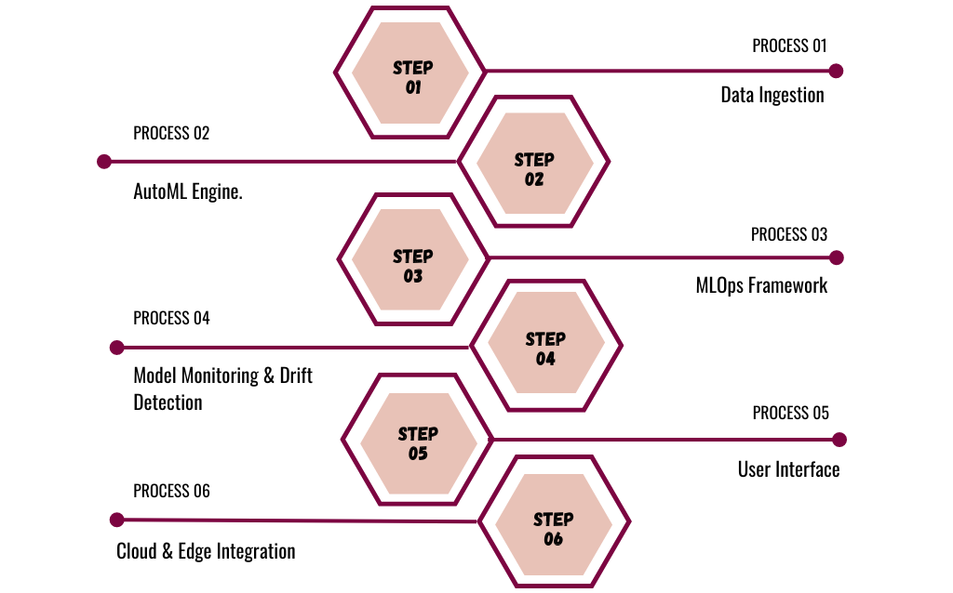
Architecture/Flow Diagram
Supports batch and real-time data ingestion.
Handles automated model selection, training, and hyperparameter tuning.
Manages the lifecycle of the models from training to deployment, including CI/CD pipelines.
Real-time monitoring of model performance, with automated retraining triggers.
A web-based, user-friendly dashboard with drag-and-drop functionality and customizable views.
Flexible deployment across cloud, on-premise, and edge devices.

Slide 8
Summary
The proposed platform builds upon the strengths of H2O.ai by providing:
Full MLOps integration with continuous deployment and monitoring.
Enhanced model explainability and compliance features.
Multi-cloud, hybrid, and edge deployment options.
Customizable pipelines, better data preparation, and team collaboration tools.
A more intuitive and flexible interface.

Slide 9


Thank you!

